Slide 1
WELCOME

Slide 2

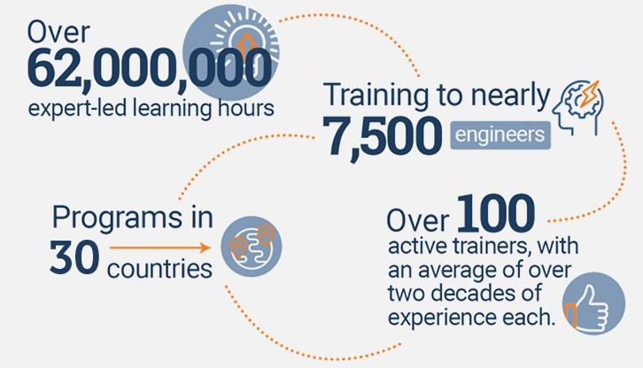
An Overview
Our purpose…
We help organizations learn and adopt new technologies.
In 2018 alone...
…Impacts you daily.
When you talk on the phone, watch a movie, connect with friends on social media, drive a car, fly on a plane, pay with a credit card, shop online, and order a latte with your mobile app, you are interacting with technology developed by one of our customers.
Notes:
Share a bit about DevelopIntelligence
- As developers you want to learn!
- As a corporation you want your developers to align their learning with your business goals.
- That’s where we come in… Keeping developers current, bringing others up-to-speed … all aimed at moving your business forward!
- We started in 2003 by a Sun Microsystems developer that wanted to help developers level-up and see business better leverage IT

Slide 3
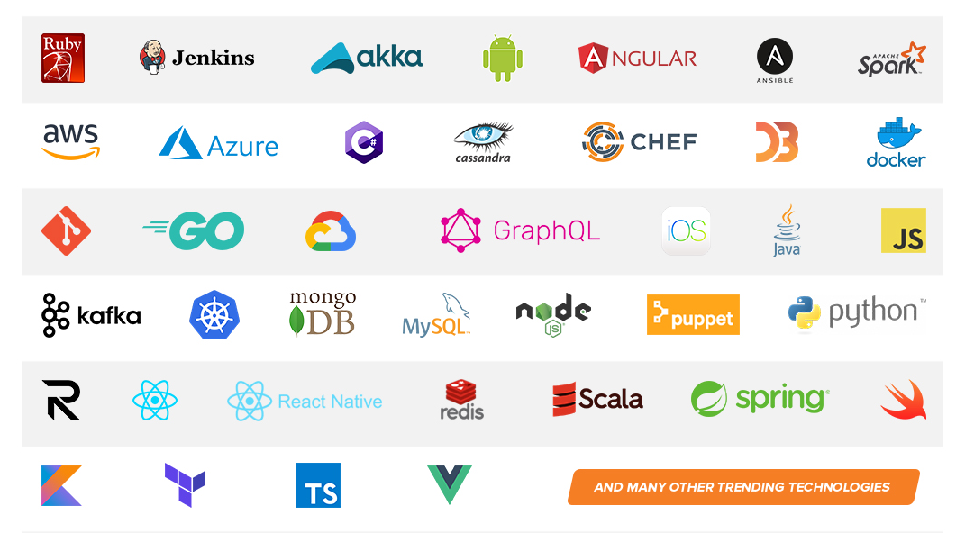
Technologies we cover
Notes:
Areas of DevelopIntelligence expertise
DevOps: Ansible / Jenkins
BigData: Hadoop / Cassandra / Spark
Machine Learning
Front-end: React / Angular
Cloud: AWS / Azure / Google Cloud
- Started as a Java shop -> keep growing -> haven’t looked back
- Our specialty is hiring expert practitioners that can come alongside teams and teach them how to move forward

Slide 4
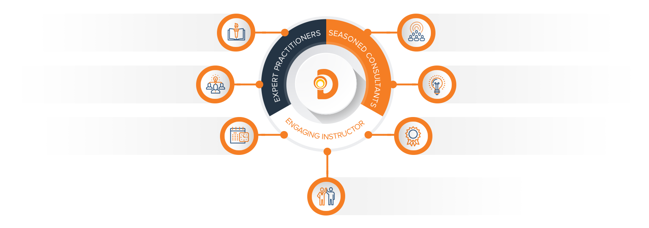
Our Practitioners
250 best selling
books authored
150 engagements speaking
at industry conferences
9+ years of training
experience
Over 17 years of industry
experience per instructor
750,000 practitioner led
training hours
125 certifications in leading
technologies
95% instructor satisfaction

Slide 5
Snowflake
Instructor Name
Credentials

Slide 6
About the instructor

Slide 7
What is Snowflake?
” Snowflake is a data warehouse built on top of the Amazon Web Services or Microsoft Azure cloud infrastructure. There’s no hardware or software to select, install, configure, or manage, so it’s ideal for organizations that don’t want to dedicate resources for setup, maintenance, and support of in-house servers.”
--Snowflake Handbook

Slide 8
Why Snowflake?
Has anyone ever set up a MYSQL, POSTGRESQL, MSSQL, ORACLE or other data warehouse instance?
What are some of the issues that you had to face?
What are some of the hardships?
How do you handle demand changes ?
How do you handle high query demands?

Slide 9
What does Snowflake offer?
Let’s divide data warehouses into three parts:
Storage: for storing data and
Computing: which is what allows us to do all the things we do in structured SQL databases
Services: Which are some of the things like pipelines, etc.
Snowflake offers us the opportunity to independently scale the storage, services, and the computing. Why is this important?

Slide 10
Snowflake Intro
“Snowflake is a single integrated solution with completely independent scaling for compute, storage and services. Unlike shared-storage architectures that bundle storage and compute together, Snowflake enables instant, automatic scaling of storage, analytics, or workgroup resources for any job at any time.”
-- Snowflake handbook

Slide 11
Snowflake Architecture
Starting with our conception that there are three layers (storage, computing, services) to a data warehouse we would want to separate those out.
For storage let’s keep everything in file formats (AVRO, JSON, etc).
Think data lake… a large data repository accessible by multiple clusters.
NOW- For the computing layer we would want clusters of computers set up to share resources for running computations on that storage.
Finally in the services layer we want access from our cloud service provider.

Slide 12
Snowflake architecture

Slide 13
Snowflake Intro: Storage
Storage:
So in our storage layer we can keep structured or semi-structured data that Snowflake completely manages for us! (I can’t adequately emphasize how awesome this is!)
Snowflake automatically manages all aspects of how the data is stored: organization, file size, structure, compression, metadata, and statistics. This storage layer runs independently of compute resources.
Storage is billed in terabytes per month and is incredibly cheap.

Slide 14
Snowflake Intro: Computing Layer
Computing:
The compute layer is made up of virtual warehouses that execute data processing tasks required for queries. Each virtual warehouse (or cluster) can access all the data in the storage layer, then work independently, so the warehouses do not share, or compete for, compute resources.
This enables nondisruptive, automatic scaling, which means that while queries are running, compute resources can scale without the need to redistribute or rebalance the data in the storage layer.

